Slide 1

Securing Smart Environments with Authentic Execution
Candidate: Gianluca Scopelliti
Thesis advisor: Prof. Cataldo Basile
Supervisors: Prof. Frank Piessens Dr. Jan Tobias Mühlberg Ir. Fritz Alder

Slide 2
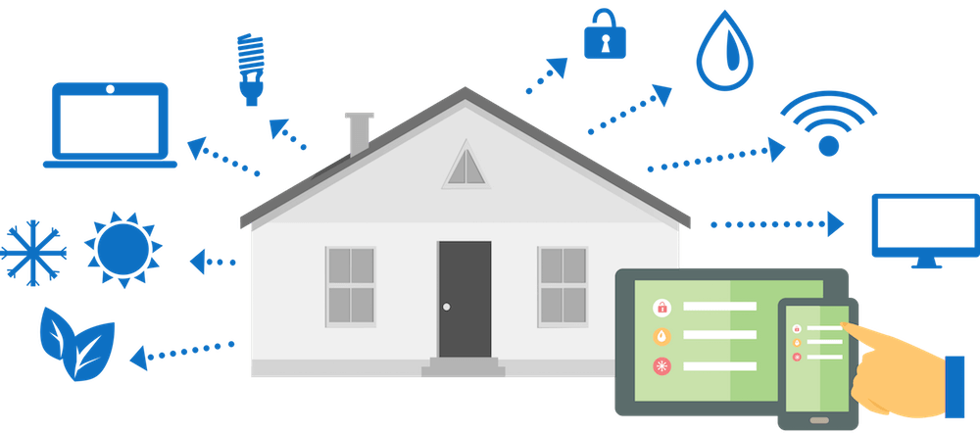
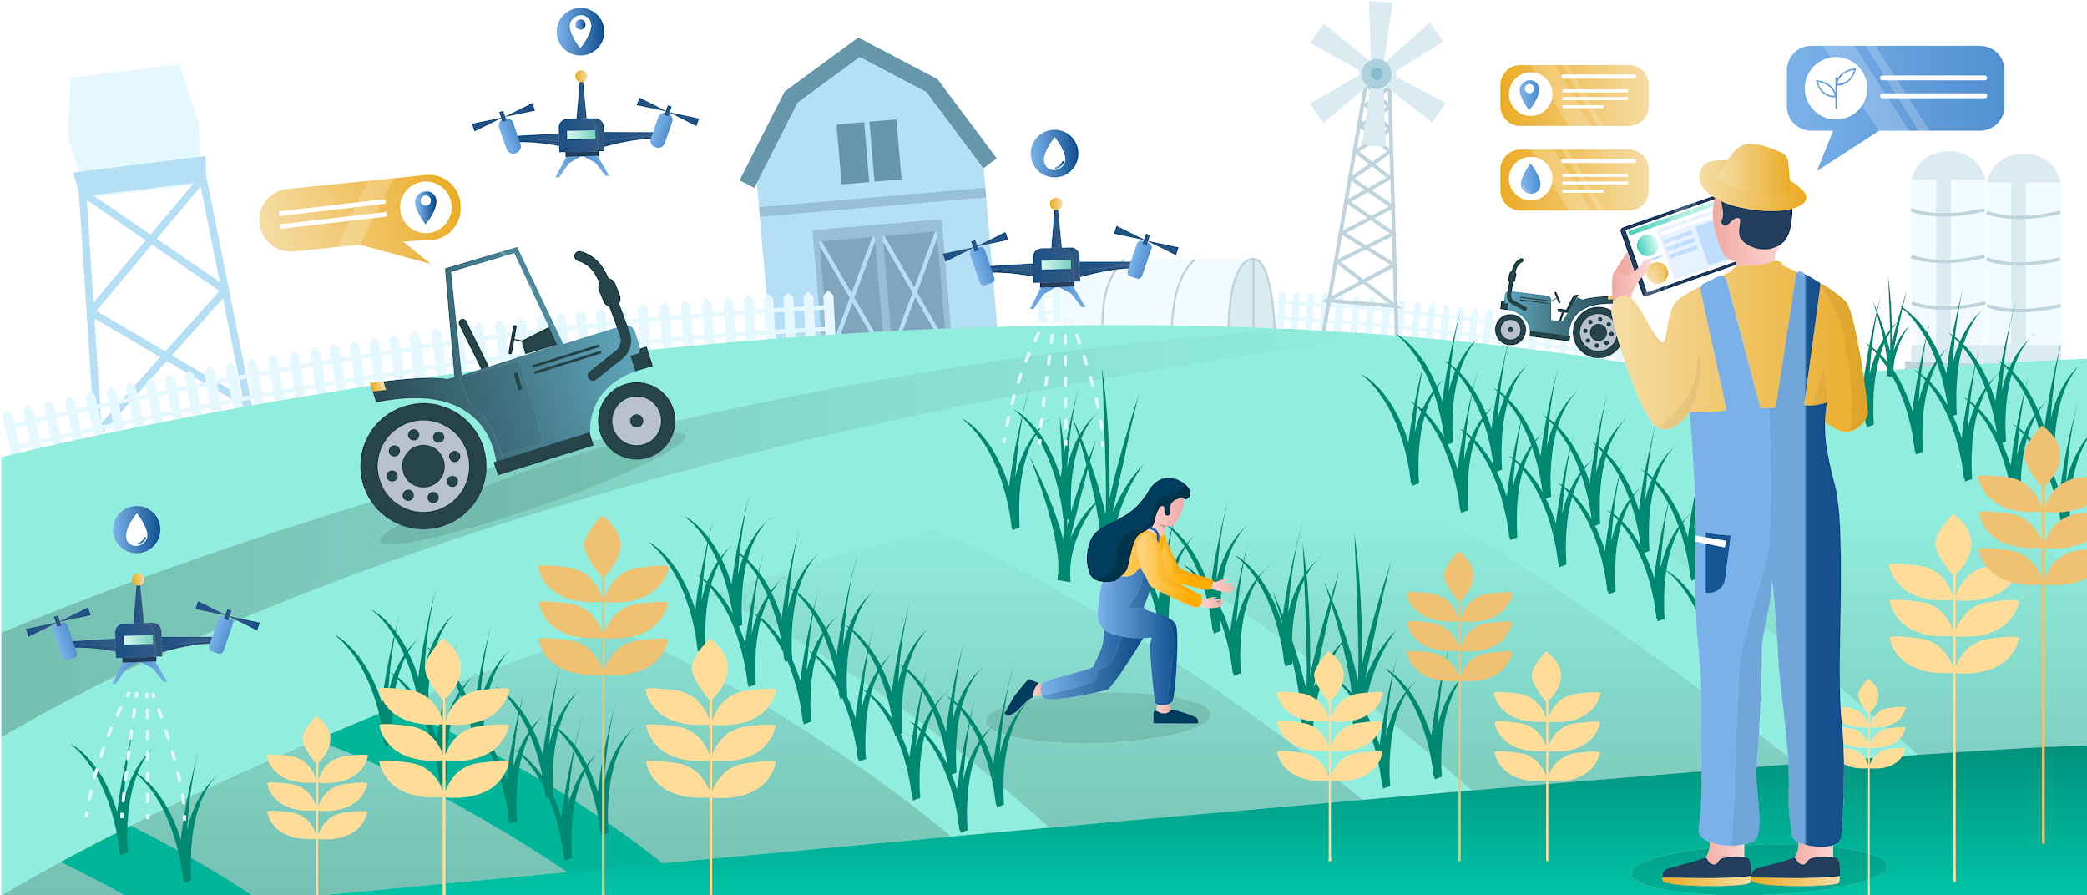
What are Smart Environments?
Distributed applications
Connected to the physical world
Heterogeneous
(optional) user intervention
Examples:
Smart home
Smart farming

Slide 3

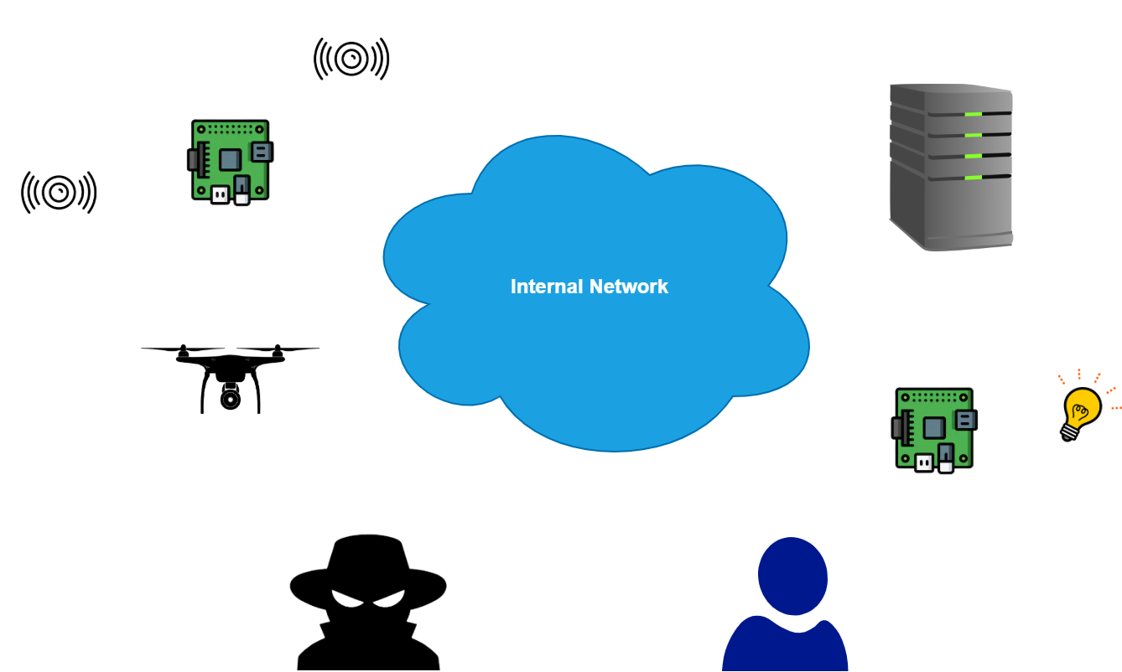
Security Issues
Integrity & authenticity of the interaction with I/O devices (bi-directional)
Authenticity of the software running on each node
Confidentiality & integrity of sensitive data located in memory
Confidentiality, integrity & authenticity of sensitive data stored on disk
Confidentiality, integrity & authenticity of sensitive data on the network
Notes:
sw eseguito su tutte le piattaforme
messaggi nella rete e comunicazione con IO devices
User: authentication
Dati all’interno dei sistemi in RAM e in storage

Slide 4
Research question
How can we protect a system from all the security issues seen before?
While, at the same time, minimizing the Trusted Computing Base (TCB)
The system might be:
Heterogeneous
Distributed

Slide 5
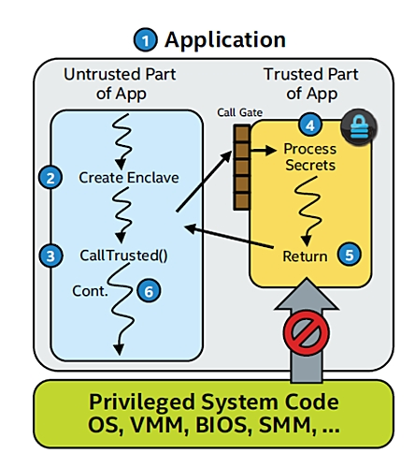
Trusted Execution Environment (TEE)
Isolation of sensitive code and data
Reduction of the attack surface (TCB)
Authentication of the running software (Remote Attestation)
Examples of TEEs:
Intel Security Guard Extensions (SGX)
ARM TrustZone
Sancus
Notes:
Find another image?
Attack surface
Remote Attestation
Trusted paths
Bonus: Secure I/O & sealing

Slide 6
State of the art
Trusted paths between high-end nodes and I/O devices
BitE: I/O devices with crypto capabilities, no TEE
Bumpy: BitE + Flicker TEE
SGXIO, seL4: SGX machines with kernel modifications
SGX-USB: proxy devices between SGX platform and I/O peripherals
Fidelius: SGX machines and trusted I/O devices
These solutions do not provide heterogeneity
Not suitable for Smart Environments
No embedded TEEs used
Notes:
TODO

Slide 7
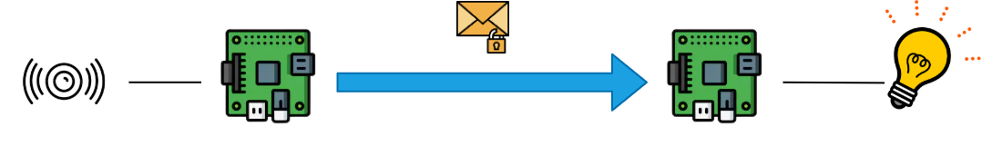
Authentic Execution
Goal: strong assurance of the correct execution of a distributed application
Its principles can be applied to any TEE -> heterogeneity!
The real implementation only supports Sancus
Using the Secure I/O feature
Notes:
A popup with limitations: only for sancus! (why is it a limitation)

Slide 8
Contributions of this Thesis
Design & Implementation of Authentic Execution for Intel SGX
Ensuring compatibility between Sancus and SGX
Developing tools for automatic deployment
Design & Implementation of a prototype for smart irrigation
Evaluation of the prototype: code, performance, security

Slide 9
Authentic Execution SGX
Design: how to apply the high-level concepts of the paper to this context
Programming languages, frameworks, data structures..
Small extensions to the framework
Application-level network protocol compatible with Sancus
Implementation: framework written entirely in Rust
Modern, fast programming language
Secure by design
Notes:
TODO

Slide 10
Prototype
Simple smart irrigation system
Four modules:
Sensor
Actuator
Controller
Dashboard
No real I/O devices
Sensor -> simulated in software
Actuator -> Used an LED with Secure I/O

Slide 11
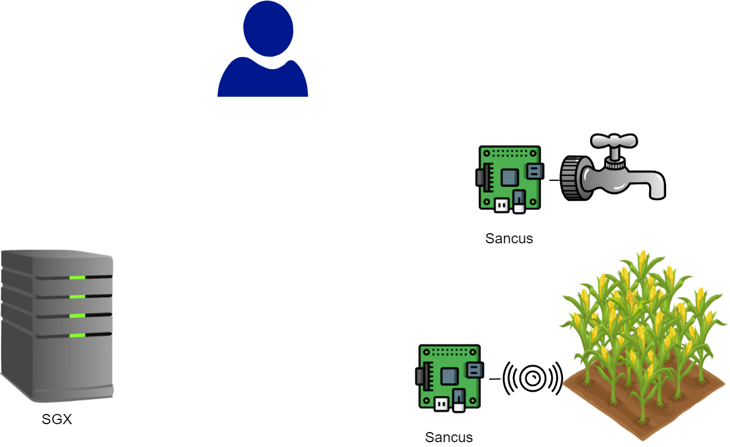

Prototype (cont’d)
Is the irrigation system ON?
Yes
Activate the irrigation system
Actuator
Dashboard
Irrigation system is ON
Give me the current moisture level
Controller
The current moisture level is: XXX
Sensor
Notes:
Very brief motivation of the use case
Explain the cycle - use of Sancus & SGX together
No complete prototype! No sensors - LED - simple logic - UART
Three different configurations

Slide 12
Conclusions
Code: very small TCB
Thanks to isolation mechanisms of TEEs
Minimised developer effort (between 24 and 53 SLOC for each component’s logic)
Security:
Strong integrity
Confidentiality of sensitive data
Notes:
security: theoretical analysis based on eight different threat scenarios - explanation if and why our system is secure
performance: caused by overhead of using TEE + sw implementation of crypto libraries

Slide 13
Conclusions (cont’d)
Performance:
Response time in the order of ~100ms
OK smart irrigation, possible issues with stricter real time requirements
Future work:
Test a complete prototype
Improve performance
Add features (e.g., SGX sealing)

Slide 14
Thank you for your attention!
Questions?

